Slide 1
CPU Shcheduling

Slide 2
What is CPU Scheduling?
CPU scheduling is a process which allows one process to use the CPU while the execution of another process is on hold(in waiting state) due to unavailability of any resource like I/O etc, thereby making full use of CPU.
The aim of CPU scheduling is to make the system efficient, fast and fair.
Whenever the CPU becomes idle, the operating system must select one of the processes in the ready queue to be executed. The selection process is carried out by the short-term scheduler (or CPU scheduler).
The scheduler selects from among the processes in memory that are ready to execute, and allocates the CPU to one of them.

Slide 3
Non-Preemptive Scheduling
Under non-preemptive scheduling, once the CPU has been allocated to a process, the process keeps the CPU until it releases the CPU either by terminating or by switching to the waiting state.
This scheduling method is used by the Microsoft Windows 3.1 and by the Apple Macintosh operating systems.
It is the only method that can be used on certain hardware platforms, because It does not require the special hardware(for example: a timer) needed for preemptive scheduling.

Slide 4
Preemptive Scheduling
In this type of Scheduling, the tasks are usually assigned with priorities.
At times it is necessary to run a certain task that has a higher priority before another task although it is running.
Therefore, the running task is interrupted for some time and resumed later when the priority task has finished its execution.

Slide 5
Types of CPU Scheduling
CPU scheduling decisions may take place under the following four circumstances:
When a process switches from the running state to the waiting state(for I/O request or invocation of wait for the termination of one of the child processes).
When a process switches from the running state to the ready state (for example, when an interrupt occurs).
When a process switches from the waiting state to the ready state(for example, completion of I/O).
When a process terminates.

Slide 6
CPU Scheduling: Scheduling Criteria
CPU Utilization
To make out the best use of CPU and not to waste any CPU cycle, CPU would be working most of the time(Ideally 100% of the time). Considering a real system, CPU usage should range from 40% (lightly loaded) to 90% (heavily loaded.)
Throughput
It is the total number of processes completed per unit time or rather say total amount of work done in a unit of time. This may range from 10/second to 1/hour depending on the specific processes.

Slide 7
Turnaround Time
It is the amount of time taken to execute a particular process, i.e. The interval from time of submission of the process to the time of completion of the process(Wall clock time).
Waiting Time
The sum of the periods spent waiting in the ready queue amount of time a process has been waiting in the ready queue to acquire get control on the CPU.

Slide 8
Load Average
It is the average number of processes residing in the ready queue waiting for their turn to get into the CPU.
Response Time
Amount of time it takes from when a request was submitted until the first response is produced. Remember, it is the time till the first response and not the completion of process execution(final response).
In general CPU utilization and Throughput are maximized and other factors are reduced for proper optimization.

Slide 9
Scheduling Algorithms
To decide which process to execute first and which process to execute last to achieve maximum CPU utilisation, computer scientists have defined some algorithms, they are:
First Come First Serve(FCFS) Scheduling
Shortest-Job-First(SJF) Scheduling
Priority Scheduling
Round Robin(RR) Scheduling
Multilevel Queue Scheduling
Multilevel Feedback Queue Scheduling

Slide 10
First Come First Serve (FCFS)
Jobs are executed on first come, first serve basis.
It is a non-preemptive algorithm.
Easy to understand and implement.
Its implementation is based on FIFO queue.
Poor in performance as average wait time is high.

Slide 11
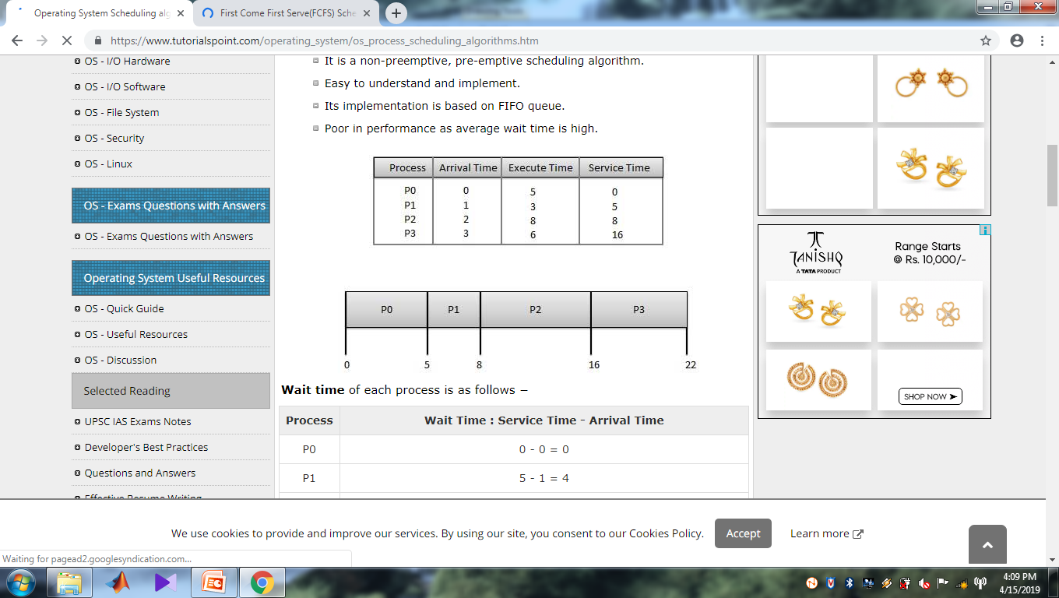

Slide 12
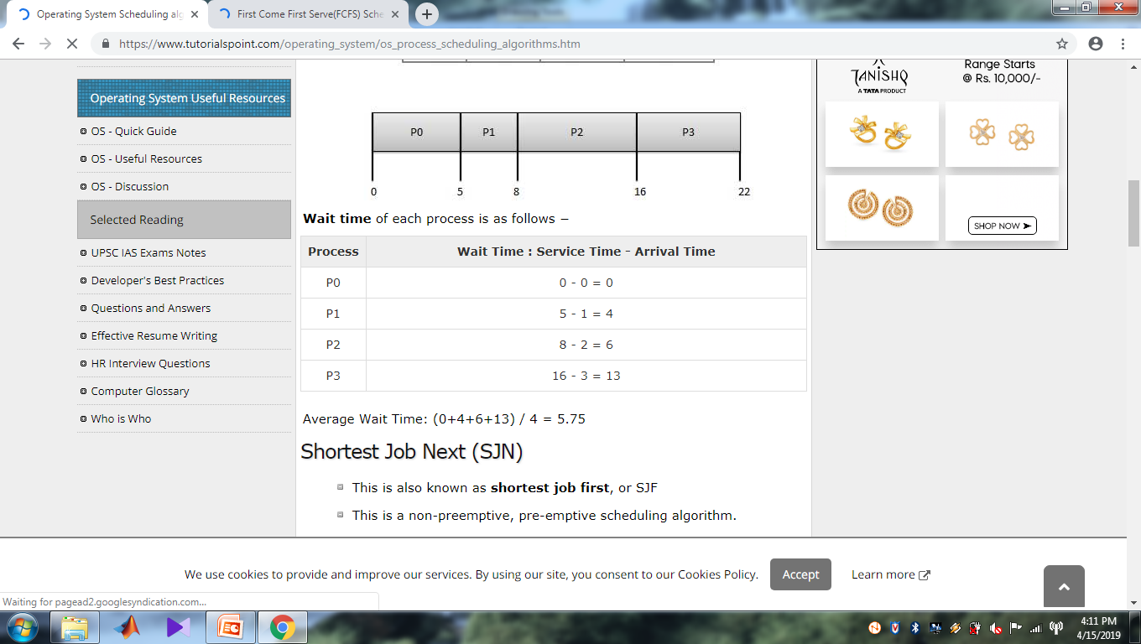

Slide 13
Shortest Job Next (SJN)
This is also known as shortest job first, or SJF
This is a non-preemptive, pre-emptive scheduling algorithm.
Best approach to minimize waiting time.
Easy to implement in Batch systems where required CPU time is known in advance.
Impossible to implement in interactive systems where required CPU time is not known.
The processer should know in advance how much time process will take.

Slide 14
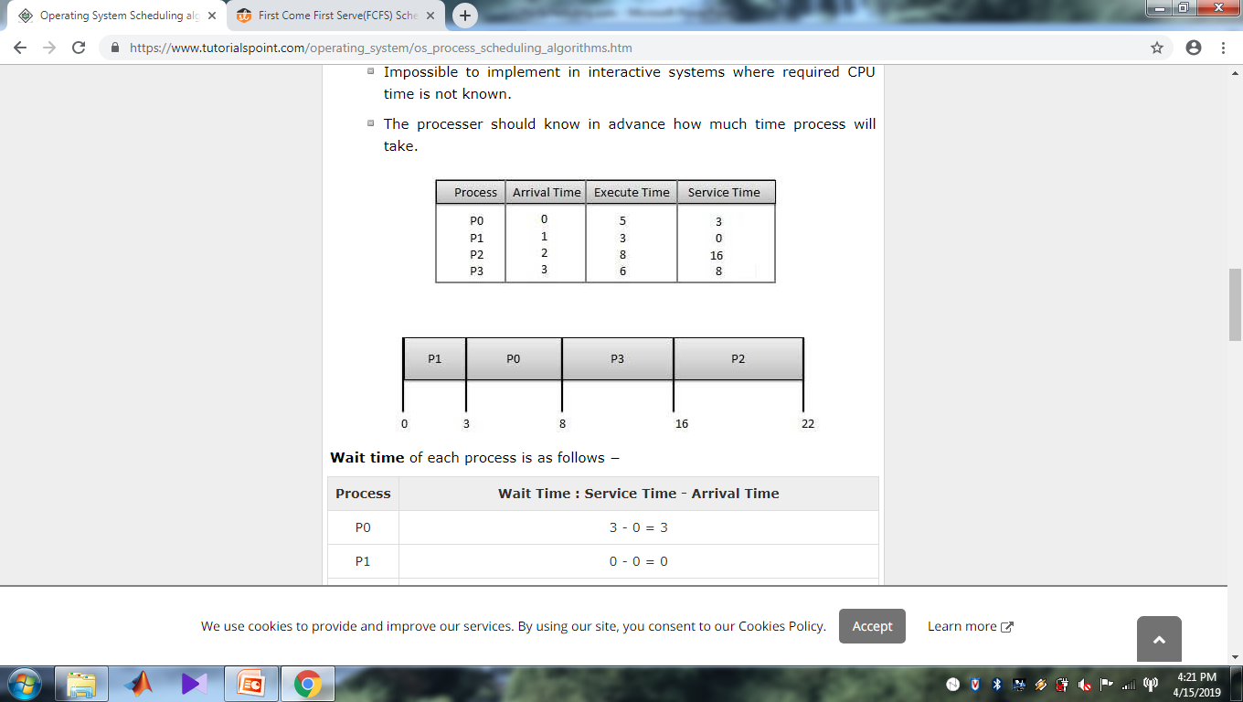

Slide 15
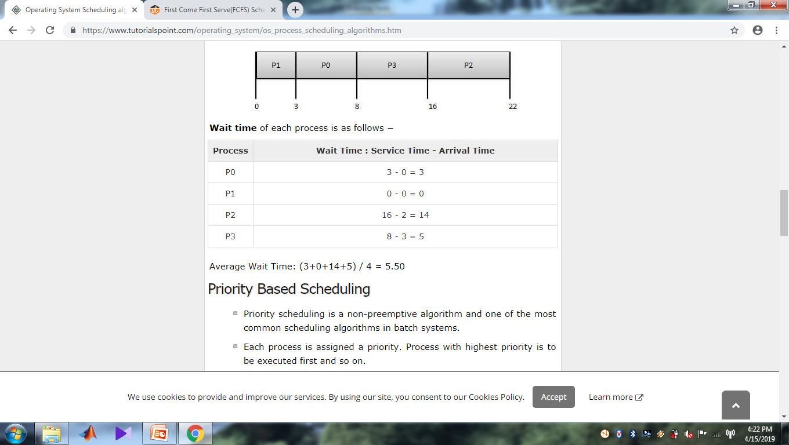

Slide 16
Priority Based Scheduling
Each process is assigned a priority. Process with highest priority is to be executed first and so on.
Processes with same priority are executed on first come first served basis.
Priority can be decided based on memory requirements, time requirements or any other resource requirement.

Slide 17
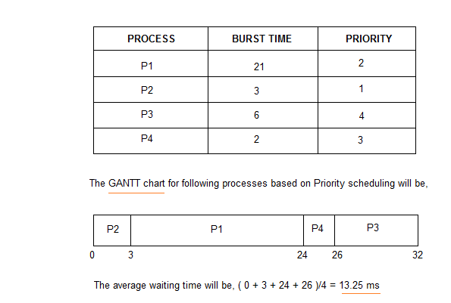

Slide 18
Round Robin Scheduling
Round Robin is the preemptive process scheduling algorithm.
Each process is provided a fix time to execute, it is called a quantum.
Once a process is executed for a given time period, it is preempted and other process executes for a given time period.
Context switching is used to save states of preempted processes.

Slide 19
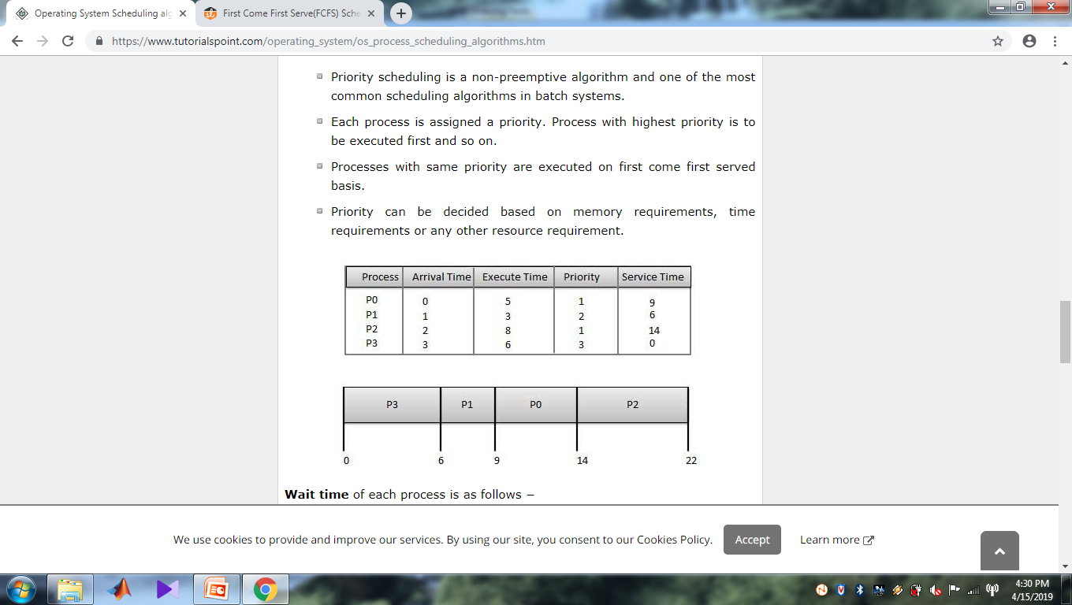

Slide 20
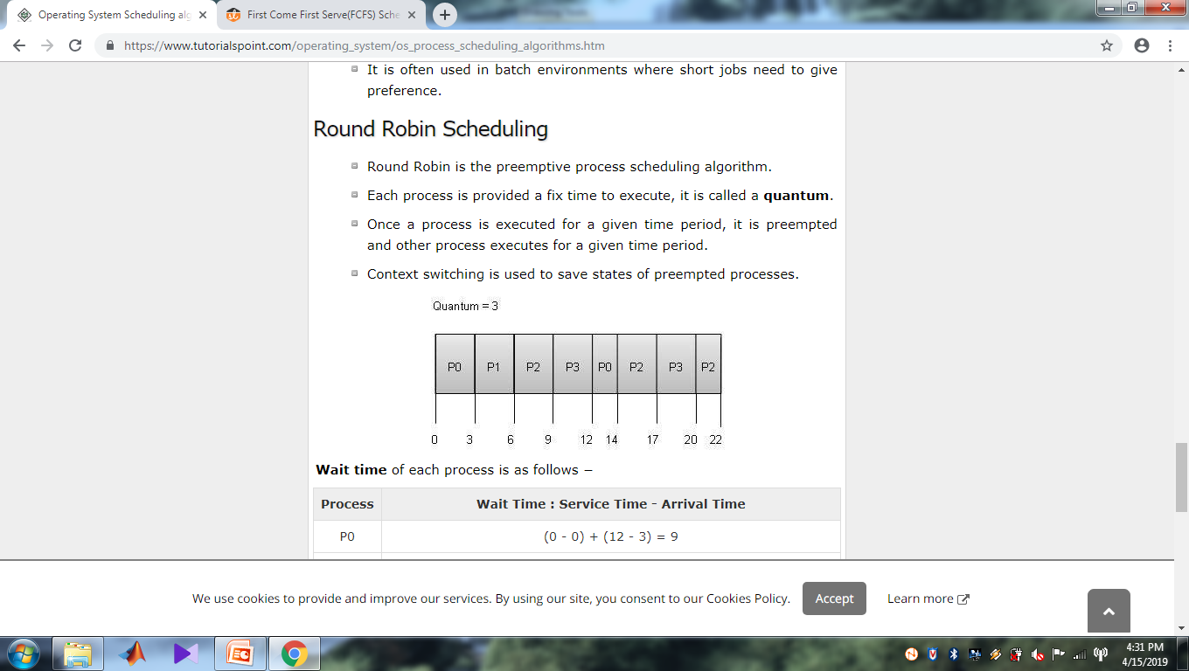

Slide 21
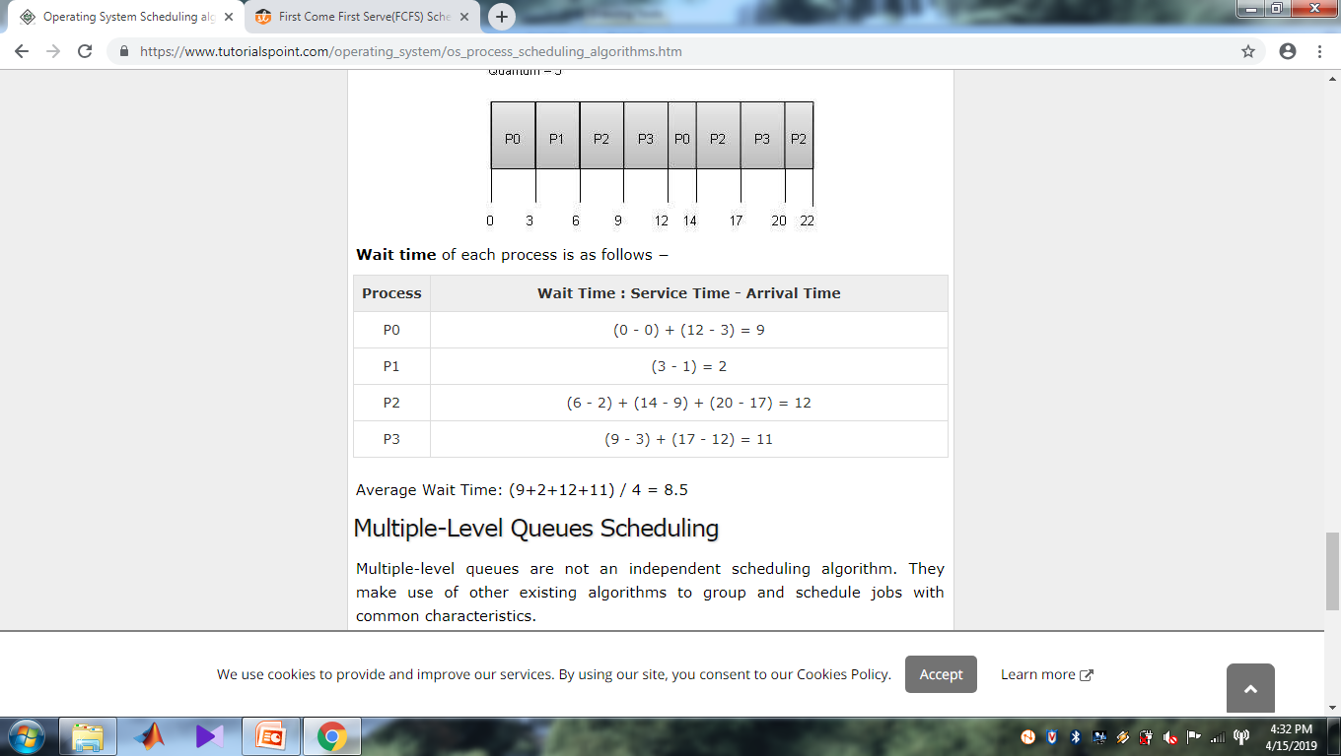

Slide 22
Multiple-Level Queues Scheduling
Multiple-level queues are not an independent scheduling algorithm. They make use of other existing algorithms to group and schedule jobs with common characteristics.
Multiple queues are maintained for processes with common characteristics.
Each queue can have its own scheduling algorithms.
Priorities are assigned to each queue.

Slide 23
For example, CPU-bound jobs can be scheduled in one queue and all I/O-bound jobs in another queue.
The Process Scheduler then alternately selects jobs from each queue and assigns them to the CPU based on the algorithm assigned to the queue.

Slide 24
Let us consider an example of a multilevel queue-scheduling algorithm with five queues:
System Processes
Interactive Processes
Interactive Editing Processes
Batch Processes
Student Processes

Slide 25
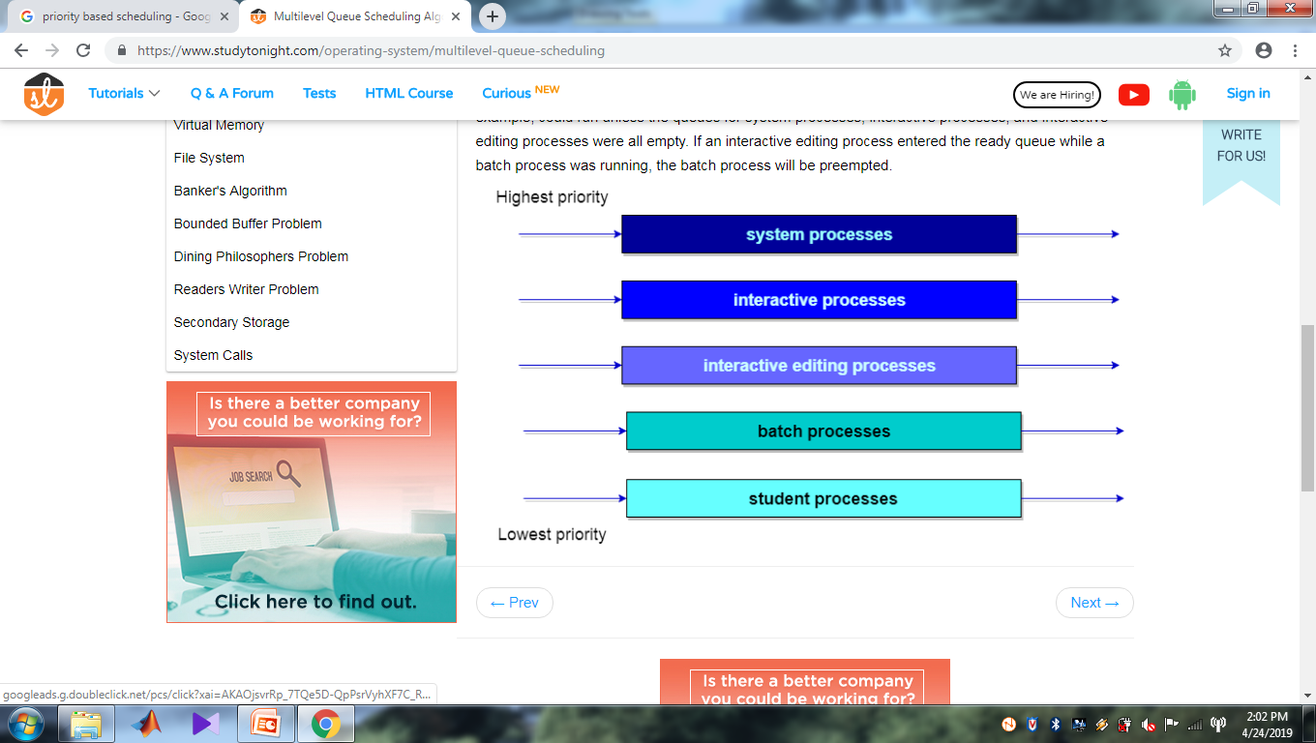

Slide 26
Multilevel Feedback Queue Scheduling
In a multilevel queue-scheduling algorithm, processes are permanently assigned to a queue on entry to the system.
Processes do not move between queues.

Slide 27
The idea is to separate processes with different CPU-burst characteristics.
If a process uses too much CPU time, it will be moved to a lower-priority queue.
Similarly, a process that waits too long in a lower-priority queue may be moved to a higher-priority queue. This form of aging prevents starvation.

Slide 28
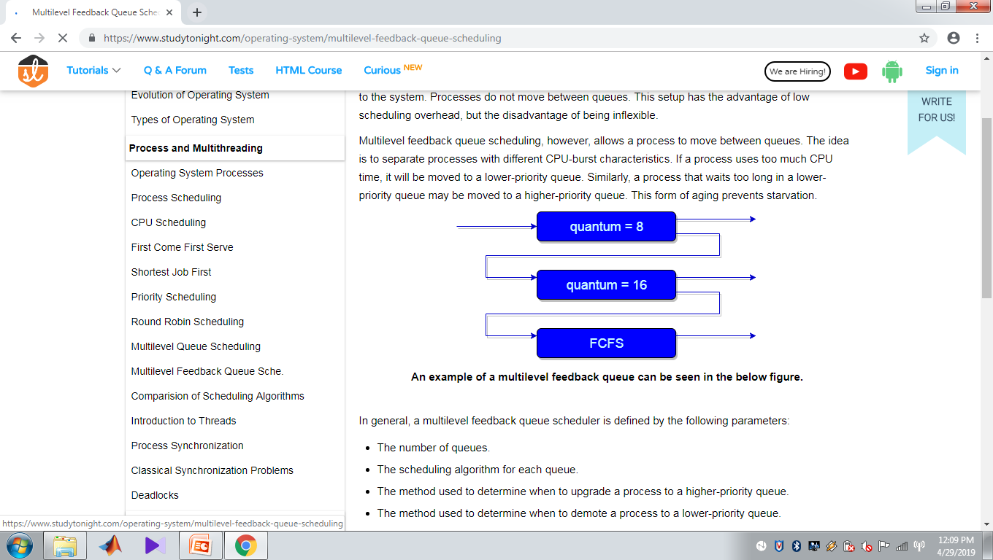

Slide 29
In general, a multilevel feedback queue scheduler is defined by the following parameters:
The number of queues.
The scheduling algorithm for each queue.
The method used to determine when to upgrade a process to a higher-priority queue.
The method used to determine when to demote a process to a lower-priority queue.
The method used to determine which queue a process will enter when that process needs service.

