Slide 1
Process Management

Slide 2
Program vs Process
A process is a program in execution. For example, when we write a program in C or C++ and compile it, the compiler creates binary code.
The original code and binary code are both programs. When we actually run the binary code, it becomes a process.
A process is an ‘active’ entity, as opposed to a program, which is considered to be a ‘passive’ entity. A single program can create many processes when run multiple times; for example, when we open a .exe or binary file multiple times, multiple instances begin (multiple processes are created).

Slide 3
Process Management
A process is mainly a program in execution where the execution of a process must progress in sequential order or based on some priority or algorithms.
In other words, it is an entity that represents the fundamental working that has been assigned to a system.
When a program gets loaded into the memory, it is said to as a process.
This processing can be categorized into four sections. These are:

Slide 4
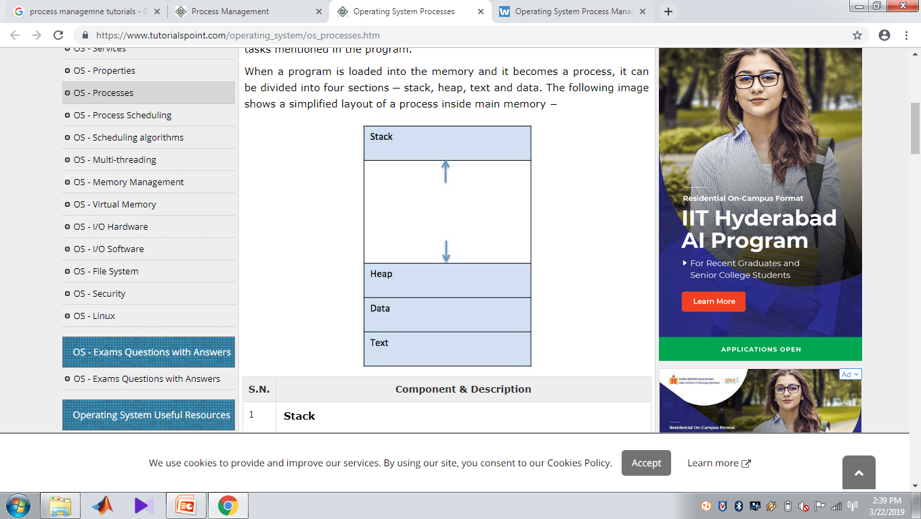

Slide 5
Stack
The process Stack contains the temporary data such as method/function parameters, return address and local variables.
Heap
This is dynamically allocated memory to a process during its run time.

Slide 6
Text
This includes the current activity represented by the value of Program Counter and the contents of the processor's registers.
Data
This section contains the global and static variables.

Slide 7
Process Life Cycle
When a process executes, it passes through different states.
These stages may differ in different operating systems, and the names of these states are also not standardized.

Slide 8
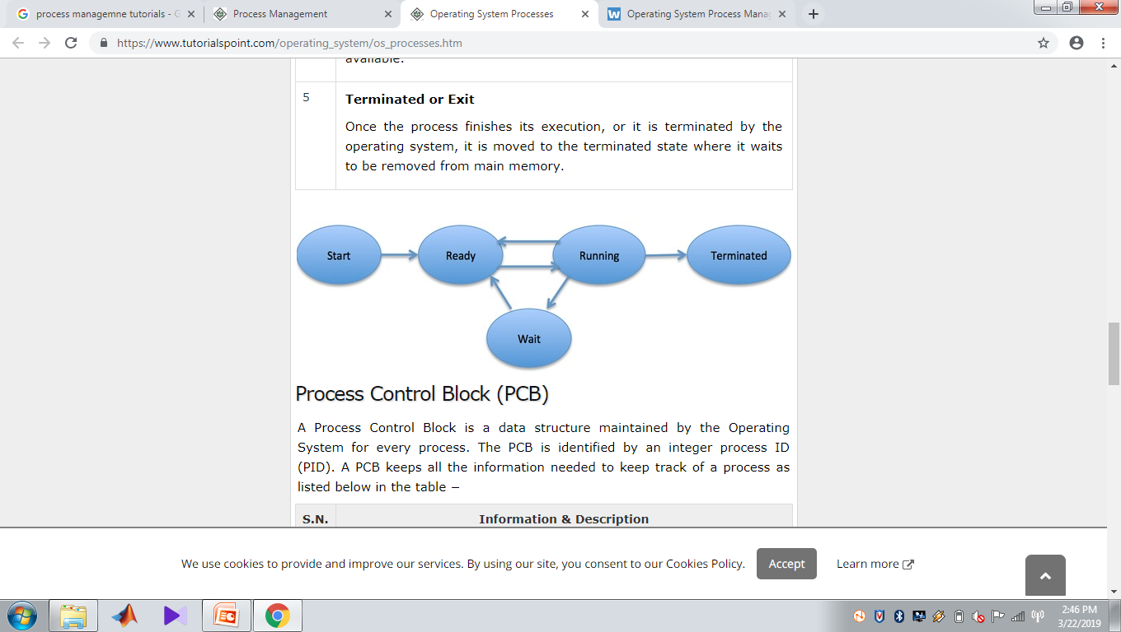

Slide 9
New- The process is in new state when it has just been created.
Ready - The process is waiting to be assigned the processor by the short term scheduler.
Running - The process instructions are being executed by the processor.
Waiting - The process is waiting for some event such as I/O to occur.
Terminated - The process has completed its execution.

Slide 10
Process Control Block (PCB)
A Process Control Block is a data structure maintained by the Operating System for every process.
The PCB is identified by an integer process ID (PID).
A PCB keeps all the information needed to keep track of a process as listed below in the table −

Slide 11
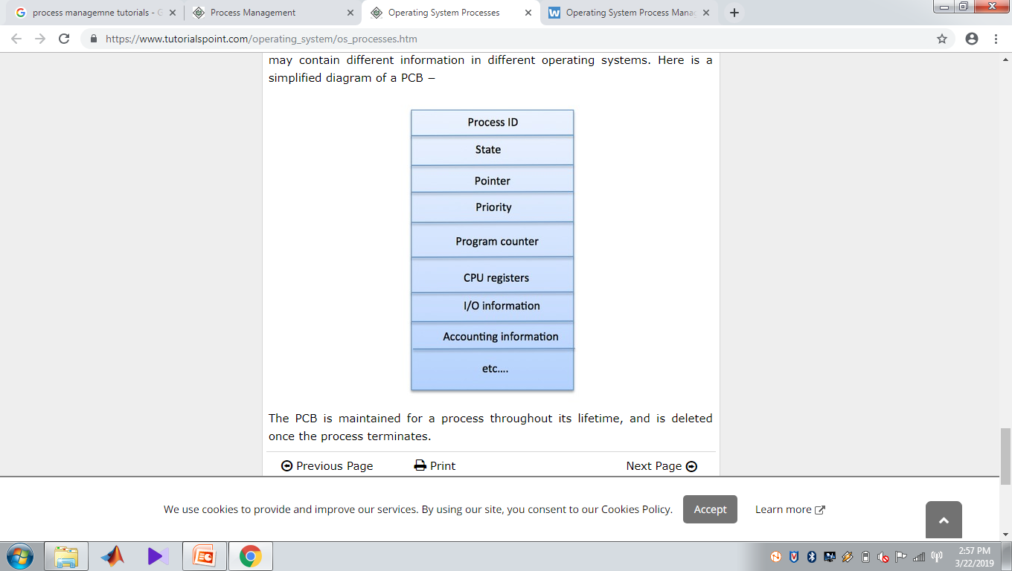

Slide 12
Process State
The current state of the process i.e., whether it is ready, running, waiting, or whatever.
Process privileges
This is required to allow/disallow access to system resources.
Process ID
Unique identification for each of the process in the operating system.

Slide 13
Pointer
A pointer to parent process.
Program Counter
Program Counter is a pointer to the address of the next instruction to be executed for this process.
CPU registers
Various CPU registers where process need to be stored for execution for running state.

Slide 14
CPU Scheduling Information
Process priority and other scheduling information which is required to schedule the process.
Memory management information
This includes the information of page table, memory limits, Segment table depending on memory used by the operating system.

Slide 15
Accounting information
This includes the amount of CPU used for process execution, time limits, execution ID etc.
IO status information
Includes a list of I/O devices allocated to the process.

Slide 16
Process Scheduling
There are many scheduling queues that are used to handle processes.
When the processes enter the system, they are put into the job queue.
The processes that are ready to execute in the main memory are kept in the ready queue.
The processes that are waiting for the I/O device are kept in the device queue.
The different schedulers that are used for process scheduling are:

Slide 17
Long Term Scheduler
The job scheduler or long term scheduler selects processes from the storage pool and loads them into memory for execution.
The job scheduler must select a careful mixture of I/O bound and CPU bound processes to yield optimum system throughput.
If it selects too many CPU bound processes then the I/O devices are idle and if it selects too many I/O bound processes then the processor has nothing to do.

Slide 18
Short Term Scheduler
The short term scheduler selects one of the processes from the ready queue and schedules them for execution.
The short term scheduler executes much more frequently than the long term scheduler as a process may execute only for a few milliseconds.

Slide 19
Medium Term Scheduler
The medium term scheduler swaps out a process from main memory.
It can again swap in the process later from the point it stopped executing.
This is helpful in reducing the degree of multiprogramming. Swapping is also useful to improve the mix of I/O bound and CPU bound processes in the memory.

Slide 20
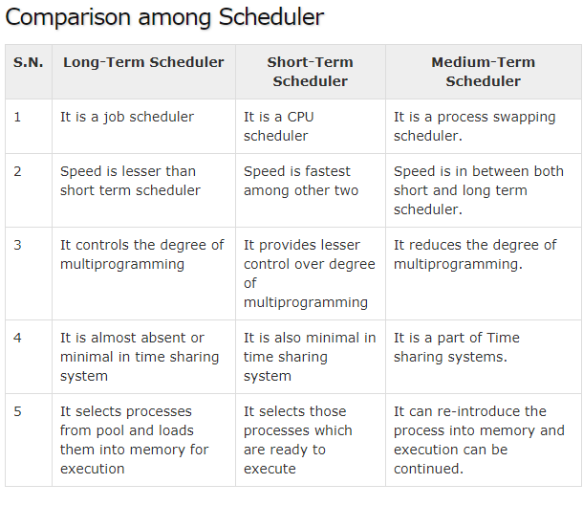

Slide 21
Context Switching
Removing a process from a CPU and scheduling another process requires saving the state of the old process and loading the state of the new process.
This is known as context switching. The context of a process is stored in the Process Control Block (PCB) and contains the process register information, process state and memory information.
The dispatcher is responsible for context switching.

Slide 22
It saves the context of the old process and gives control of the CPU to the process chosen by the short term scheduler.
When the scheduler switches the CPU from executing one process to execute another, the state from the current running process is stored into the process control block.
After this, the state for the process to run next is loaded from its own PCB and used to set the PC, registers, etc.
At that point, the second process can start executing.

Slide 23
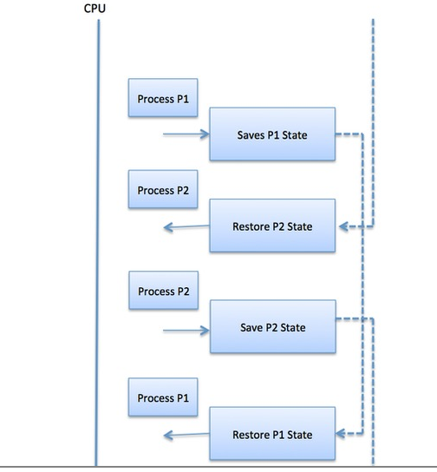

Slide 24
Context switches are computationally intensive since register and memory state must be saved and restored.
To avoid the amount of context switching time, some hardware systems employ two or more sets of processor registers.

Slide 25
When the process is switched, the following information is stored for later use.
Program Counter
Scheduling information
Base and limit register value
Currently used register
Changed State
I/O State information
Accounting information

Slide 26
Process Operations in operating system
The operations of process carried out by an operating system are primarily of two types:
Process creation
Process termination

Slide 27
1) Process Creation
Process creation is a task of creating new processes.
There are different situations in which a new process is created. There are different ways to create new process.
A new process can be created at the time of initialization of operating system or when system calls such as fork () are initiated by other processes.

Slide 28
The process, which creates a new process using system calls, is called parent process while the new process that is created is called child process.
The child processes can create new processes using system calls.
A new process can also create by an operating system based on the request received from the user.
For instance, a new process is created every time a user logs on to a computer system, an application program such a MS Word is initiated, or when a document printed.

Slide 29
2) Process termination
Process termination is an operation in which a process is terminated after the execution of its last instruction.
This operation is used to terminate or end any process.
When a process is terminated, the resources that were being utilized by the process are released by the operating system.

Slide 30
When a child process terminates, it sends the status information back to the parent process before terminating. The child process can also be terminated by the parent process if the task performed by the child process is no longer needed.
In addition, when a parent process terminates, it has to terminate the child process as well became a child process cannot run when its parent process has been terminated.

Slide 31
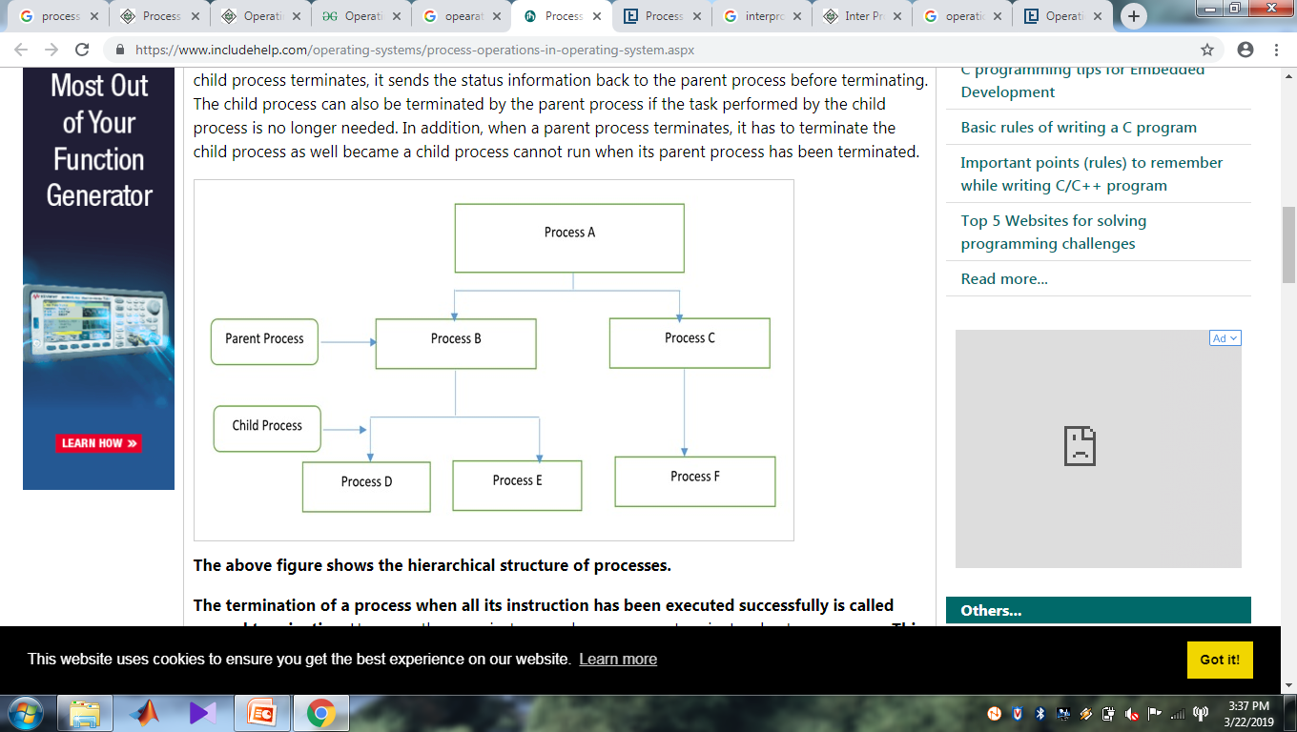

Slide 32
The termination of a process when all its instruction has been executed successfully is called normal termination. However, there are instances when a process terminates due to some error.
This termination is called as abnormal termination of a process.

Slide 33
Inter process communication (IPC)
Interprocess communication (IPC) is a set of programming interfaces that allow a programmer to coordinate activities among different program processes that can run concurrently in an operating system.
This allows a program to handle many user requests at the same time.
Since even a single user request may result in multiple processes running in the operating system on the user's behalf, the processes need to communicate with each other. The IPC interfaces make this possible.
Each IPC method has its own advantages and limitations so it is not unusual for a single program to use all of the IPC methods.

Slide 34
Basics of Inter Process Communication
Information sharing: Since some users may be interested in the same piece of information (for example, a shared file), you must provide a situation for allowing concurrent access to that information.
Computation speedup: If you want a particular work to run fast, you must break it into sub-tasks where each of them will get executed in parallel with the other tasks.
Note that such a speed-up can be attained only when the computer has compound or various processing elements like CPUs or I/O channels.

Slide 35
Modularity: You may want to build the system in a modular way by dividing the system functions into split processes or threads.
Convenience: Even a single user may work on many tasks at a time. For example, a user may be editing, formatting, printing, and compiling in parallel

Slide 36
There are two primary models of interprocess communication:
shared memory and
message passing.

Slide 37
In the shared-memory model, a region of memory which is shared by cooperating processes gets established.
Processes can be then able to exchange information by reading and writing all the data to the shared region.
In the message-passing form, communication takes place by way of messages exchanged among the cooperating processes.

Slide 38
