Slide 1
Components of operating system

Slide 2
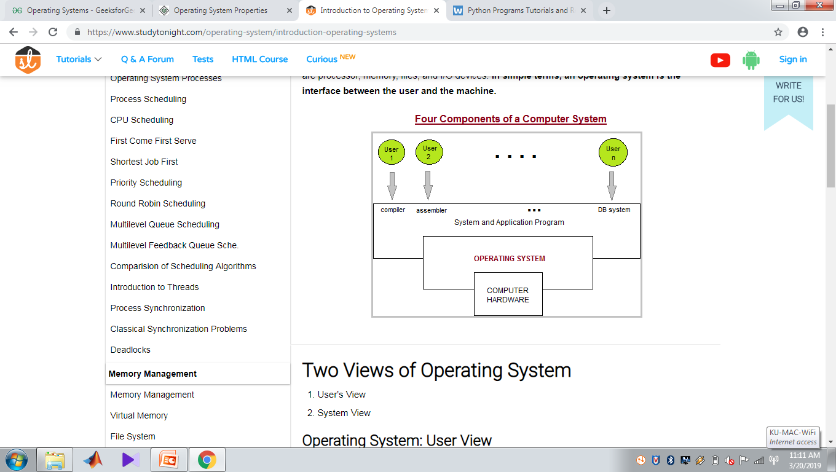
Components of operating system

Slide 3
Components of operating system
Four components
The hardware
The operating system
The application programs
And the user
The hardware –the central processing unit(CPU),the memory , and the input/output(I/O) devices –provides the basic computing resources for the system.
The application programs-such as word processors , spreadsheets , compilers , and web browsers-define the ways in which these resources are used to solve users computing problems.

Slide 4
The operating system controls the hardware and coordinates its use among the various application programs for the various users.
We can also view a computer system as consisting of hardware , software ,and data.
The operating system provides the means for proper use of these resources in the operation of the computer system.

Slide 5
Two Views of Operating System
User's View
System View

Slide 6
Operating System: User View
The user view of the computer refers to the interface being used.
Such systems are designed for one user to monopolize its resources, to maximize the work that the user is performing.
In these cases, the operating system is designed mostly for ease of use, with some attention paid to performance, and none paid to resource utilization.

Slide 7
Operating System: System View
Operating system can be viewed as a resource allocator also.
A computer system consists of many resources like - hardware and software - that must be managed efficiently.
The operating system acts as the manager of the resources, decides between conflicting requests, controls execution of programs etc.

Slide 8
Operating system services
An Operating System provides services to both the users and to the programs.
It provides programs an environment to execute.
It provides users the services to execute the programs in a convenient manner.

Slide 9
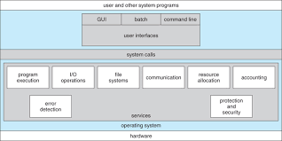

Slide 10
Following are a few common services provided by an operating system −
Program execution
I/O operations
File System manipulation
Communication
Error Detection
Resource Allocation
Protection

Slide 11
Program execution
Operating systems handle many kinds of activities from user programs to system programs like printer spooler, name servers, file server, etc.
Each of these activities is encapsulated as a process.
A process includes the complete execution context (code to execute, data to manipulate, registers, OS resources in use).

Slide 12
Following are the major activities of an operating system with respect to program management −
Loads a program into memory.
Executes the program.
Handles program's execution.
Provides a mechanism for process synchronization.
Provides a mechanism for process communication.
Provides a mechanism for deadlock handling.

Slide 13
I/O Operation
An I/O subsystem comprises of I/O devices and their corresponding driver software.
Drivers hide the peculiarities of specific hardware devices from the users.
An Operating System manages the communication between user and device drivers.
I/O operation means read or write operation with any file or any specific I/O device.
Operating system provides the access to the required I/O device when required.

Slide 14
File system manipulation
A file represents a collection of related information. Computers can store files on the disk (secondary storage), for long-term storage purpose.
Examples of storage media include magnetic tape, magnetic disk and optical disk drives like CD, DVD.
Each of these media has its own properties like speed, capacity, data transfer rate and data access methods.

Slide 15
Program needs to read a file or write a file.
The operating system gives the permission to the program for operation on file.
Permission varies from read-only, read-write, denied and so on.
Operating System provides an interface to the user to create/delete files.
Operating System provides an interface to the user to create/delete directories.
Operating System provides an interface to create the backup of file system.

Slide 16
Communication
In case of distributed systems which are a collection of processors that do not share memory, peripheral devices, or a clock, the operating system manages communications between all the processes.
Multiple processes communicate with one another through communication lines in the network.
The OS handles routing and connection strategies, and the problems of contention and security.

Slide 17
Following are the major activities of an operating system with respect to communication −
Two processes often require data to be transferred between them
Both the processes can be on one computer or on different computers, but are connected through a computer network.
Communication may be implemented by two methods, either by Shared Memory or by Message Passing.

Slide 18
Error handling
Errors can occur anytime and anywhere.
An error may occur in CPU, in I/O devices or in the memory hardware.
Following are the major activities of an operating system with respect to error handling −
The OS constantly checks for possible errors.
The OS takes an appropriate action to ensure correct and consistent computing.

Slide 19
Resource Management
In case of multi-user or multi-tasking environment, resources such as main memory, CPU cycles and files storage are to be allocated to each user or job.
Following are the major activities of an operating system with respect to resource management −
The OS manages all kinds of resources using schedulers.
CPU scheduling algorithms are used for better utilization of CPU.

Slide 20
Protection
Considering a computer system having multiple users and concurrent execution of multiple processes, the various processes must be protected from each other's activities.
Protection refers to a mechanism or a way to control the access of programs, processes, or users to the resources defined by a computer system.

Slide 21
Following are the major activities of an operating system with respect to protection −
The OS ensures that all access to system resources is controlled.
The OS ensures that external I/O devices are protected from invalid access attempts.
The OS provides authentication features for each user by means of passwords.

